Slide 1
DATA SCI 8680 BIG DATA ANALYSIS CASE STUDY: NEW JERSEY TRAVEL PATTERNS
Adam Klein, Brent Lederle, Joe Schieber

Slide 2
Mission Statement
The objective is to encourage commuting via mass transit and reduce the number of vehicles on the road in Northern New Jersey. Through analytics, we will ascertain towns with access to quality mass transit that feature a disproportionately high percentage of automotive commuters. This will reduce traffic, and also improve the environment given a decrease in automotive emissions. Towns that are analytically identified as candidates for increased mass transit usage will be the subjects of an advertising campaign to encourage and make residents aware of mass transit services that may take them to work, even if their work location is not necessarily in an urban area. Similarly, major employers may also be the subject of similar ad campaigns geared towards convincing them to offer shuttle service to train stations and bus stops.

Slide 3
Main Data Source
Travel survey data provided by the North Jersey Transportation Planning Authority. Each record in this data represents a linked trip. This means a full trip, inclusive of however many modes are involved, is represented as one trip and one record in the sheet. For example, a commute that includes driving to the train station, taking the train to New York, and taking the subway to work represents one record. In the unused “unlinked” file, a record would have been included for each of the drive to the train, train trip, and subway ride. This was not responsive to our objective. In addition to the origin and destination location information, each record included other information such as mode, personal characteristics, trip distance and duration, trip purpose, and quite a bit more.

Slide 4
Data sets included with and related to travel survey data
Person: One record for each member of a completed household.
Place: One record for each place visited by household members on travel day. Non-traveling household members have one record.
Vehicle: One record for each household vehicle (no records for zero-vehicle households).
Household: One record for each household that provided complete and usable activity and travel information.

Slide 5
Acquired Geospatial Data
State of New Jersey polygon layer. (NJ Geospatial Info Network)
New Jersey Counties polygon layer. (NJ Geospatial Info Network)
New Jersey Municipalities polygon layer. (NJ Geospatial Info Network)
New Jersey Transit Bus Stop point layer. (NJ Geospatial Info Network)
New Jersey Transit Light Rail Stop point layer. (NJ Geospatial Info Network)
New Jersey Transit Commuter Rail Station point layer. (NJ Geospatial Info Network)
New Jersey Census Tract polygon layer. (US Census Bureau)

Slide 6


Tools of analysis
Analytical
Geospatial

Slide 7
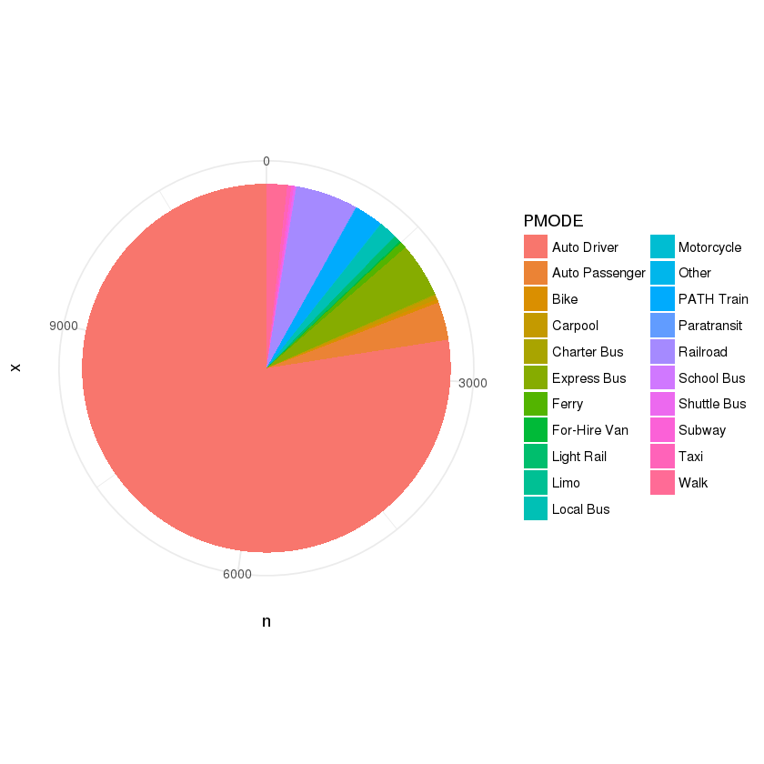
Regional level commute mode breakdown
PMODE | n | pct
Auto Driver | 8905 | 77.48%
Railroad | 626 | 5.45%
Express Bus | 551 | 4.79%
Auto Passenger | 382 | 3.32%
PATH Train | 287 | 2.50%
Walk | 208 | 1.81%
Local Bus | 177 | 1.54%
Light Rail | 68 | 0.59%
Ferry | 67 | 0.58%
Carpool | 42 | 0.37%
Taxi | 41 | 0.36%
Bike | 36 | 0.31%
Subway | 25 | 0.22%
Shuttle Bus | 20 | 0.17%
For-Hire Van | 16 | 0.14%
Charter Bus | 12 | 0.10%
Limo | 7 | 0.06%
Paratransit | 7 | 0.06%
Other | 6 | 0.05%
School Bus | 6 | 0.05%
Motorcycle | 4 | 0.03%

Slide 8
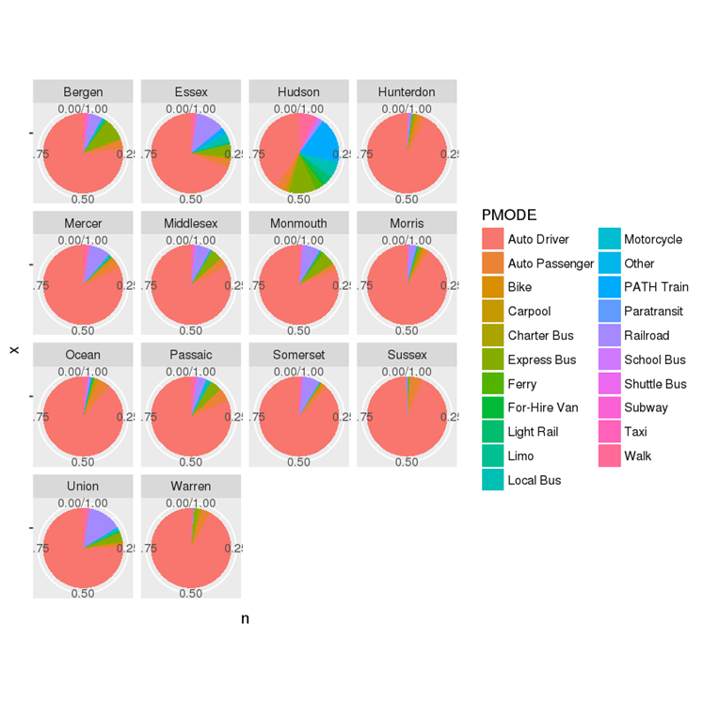
Commute mode breakdown by county

Slide 9
Statistical analysis on percentage of automotive commuters
Current number of towns in data set: 335
25th percentile automotive commuting percentage among towns: 80%
50th percentile: 87.11%
75th & 100th percentile: 100%
Minimum: 18.03% (Hoboken)
Maximum: 100% (Tie among many towns)

Slide 10
Geospatial analysis- access to transit
Goal was to identify towns that are in close proximity to mass transit as a target for transit oriented campaigning.
Selected only the 13 counties that comprise the NJTPA service area.
Created base map with county and municipal layers, and overlaid bus stop, light rail stop, and commuter rail station layers.
Buffered a five mile radius around each bus stop, light rail stop, and commuter rail station.
Performed a select by location function, where all towns touched by the buffer rings are selected, and are used to form a new layer. We can then visualize which towns are within five miles of transit, and which are not.

Slide 11
Towns in the region within five miles of any mass transit
Most of the towns in the region are within five miles of transit, however this is misleading. There are towns that are close to a bus stop which may provide local service within the county, but not to major urban employment centers. These towns are nowhere near major transit services that can carry workers from the far reaches of the State to the likes of Newark, New Brunswick, Trenton, Jersey City, or New York.

Slide 12
Towns in the region within five miles of commuter rail service
To focus on towns whose access to quality transit services are beyond a reasonable doubt, we modified the select by location query to include only towns that are within five miles of a commuter rail station. This ensures that we are targeting towns with workers that has mass transit access to major employment centers, but for some reason are not utilizing it in as great of numbers as they should be. This map shows far fewer towns, for a more effective analysis.

Slide 13
Completing our list of towns
For the layer of towns that are within five miles of a commuter rail station, we exported the attribute table and read it into R as a data frame.
We used this attribute table to reduce the data frame so that we could produce a new data frame featuring only towns that are in the 50th percentile or greater in terms of automotive commuting percentage, as well as within five miles of a commuter rail station.
Towns in the 50th percentile of above for automotive commuting: 335
Towns within five miles of a commuter rail station: 289
Towns that meet both criteria: 136

Slide 14
Attempts at data modeling
To this list of 136 target towns, we added all four ancillary data sets mentioned earlier (household, person, place, vehicle). Armed with a bevy of demographic and logistical information, we sought to apply the myriad tools of predictive analytics and machine learning to determine if there are a set of circumstances or criteria that might impact a person’s choice of commute mode.
Several different algorithms and theories were tested, including decision trees, logistic regression, linear regression, and hierarchical clustering. Regrettably, no match was identified in terms predicting commuting mode.

Slide 15
Why it didn’t work
It turns out this is not a good data set for machine learning due to the fact that among the breakdown of commute modes, automotive commuting is so overwhelmingly in the majority. Among all towns, it represents 78.48% of the sample, with commuter rail next at 5.45%. This is an accurate representation of New Jersey. Given such a high percentage of automotive commuters and low percentage of transit users and other types of commuters, the data simply cannot accurately point to factors that effect mode selection. All different types of people in all but a very few urban locations overwhelmingly drive to work. So a different approach is needed to target towns that may be receptive to programming for increased transit usage.

Slide 16
Origin destination analysis
We had initially prepared origin-destination matrices displaying the breakdown of trips from all towns in a single County, to all other Counties in the area. While informative, it was not necessarily actionable. Upon further review of the data, we noticed the OTRACT and DTRACT fields. These appeared to be census tracts. To confirm, we acquired a census tract polygon layer and compared some of the values in the OTRACT and DTRACT field to the census tract ID value in the attribute table. Not only were the same values present for both OTRACT/DTRACT and the census tract ID, but it was a geographic match on the map as well. This realization meant it would not be possible to perform an origin-destination analysis closer to the municipal level than the county level.

Slide 17
Geospatial data preparation
Unlike towns and counties, census tracts do not have names. The only way to make this data actionable would be to turn it into a geospatial data set, convert to a feature class, and perform a geospatial analysis in ArcMap.
Through data carpentry, we were able to create two new data frames: an origin points file and a destination points file. Utilizing both the attribute table containing the census tract ID as well as the geographic coordinates required for mapping, we created data frames that included the census tract id, latitude, longitude, origin county, and trip duration and distance.
This data was imported into ArcMap, converted into a shapefile, and used to execute a geospatial origin-destination analysis.

Slide 18
Mapping of origin destination data
The base map included New Jersey County and Municipal polygon layers, the NJ Transit Commuter Rail Station points layer, and both the origin and destination points layers.
The analysis was performed at the county level, to ascertain where people were traveling the greatest numbers from each county for the purposes of localized messaging. A region wide origin-destination analysis may have been too abstract. Only New Jersey destinations were included, as most who commute to New York take mass transit.
One and five mile buffer rings were calculated around each commuter rail station. The rationale is that within one mile of mass transit, people may be inclined to walk to their final destination. Within five miles of mass transit, perhaps employers could be persuaded to offer shuttle service.

Slide 19
Mapping of origin destination data
As with our earlier geospatial analysis pertaining to transit access, a select by location operation was executed to select towns that are included in both the one and five miles buffer rings.
Statistics were then calculated to determine that for all destination points for trips originating from a like county, what percentage were within walking distance of train service (one mile buffer), and what percentage were within shuttle service (five mile buffer).

Slide 20
Destinations within walking distance by county
Among all 13 counties, 22.34% of destinations are within one mile of train service, with a range of 8.65% to 30.29%
County | Total Trips | Count 1 Mile | Pct 1 Mile
Union | 175 | 53 | 30.29%
Bergen | 410 | 122 | 29.76%
Warren | 109 | 30 | 27.52%
Morris | 699 | 187 | 26.75%
Somerset | 330 | 88 | 26.67%
Middlesex | 401 | 94 | 23.44%
Monmouth | 169 | 39 | 23.08%
Passaic | 183 | 41 | 22.40%
Hudson | 38 | 8 | 21.05%
Hunterdon | 126 | 26 | 20.63%
Essex | 227 | 43 | 18.94%
Sussex | 71 | 8 | 11.27%
Ocean | 104 | 9 | 8.65%

Slide 21
Destinations within shuttle distance by county
Among all 13 counties, 84.44% of destinations are within five miles of train service, with a range of 54.81% to 100%.
This displays that transit is available to popular commuting destinations.
County | Total Trips | Count 5 Miles | Pct 5 Miles
Essex | 227 | 227 | 100.00%
Union | 175 | 166 | 94.86%
Bergen | 410 | 386 | 94.15%
Hudson | 38 | 35 | 92.11%
Passaic | 183 | 165 | 90.16%
Monmouth | 169 | 151 | 89.35%
Morris | 699 | 619 | 88.56%
Hunterdon | 126 | 111 | 88.10%
Somerset | 330 | 285 | 86.36%
Middlesex | 401 | 338 | 84.29%
Warren | 109 | 75 | 68.81%
Sussex | 71 | 47 | 66.20%
Ocean | 104 | 57 | 54.81%

Slide 22
Bergen County
Percent of destinations within one mile of a train station: 29.76%
Percent of destinations within five miles of a train station: 94.15%

Slide 23
Essex County
Percent of destinations within one mile of a train station: 18.94%
Percent of destinations within five miles of a train station: 100.00%

Slide 24
Hudson County
Percent of destinations within one mile of a train station: 21.05%
Percent of destinations within five miles of a train station: 92.11%

Slide 25
hunterdon County
Percent of destinations within one mile of a train station: 20.63%
Percent of destinations within five miles of a train station: 88.10%

Slide 26
middlesex County
Percent of destinations within one mile of a train station: 23.44%
Percent of destinations within five miles of a train station: 84.29%

Slide 27
monmouth County
Percent of destinations within one mile of a train station: 23.08%
Percent of destinations within five miles of a train station: 89.35%

Slide 28
morris County
Percent of destinations within one mile of a train station: 26.75%
Percent of destinations within five miles of a train station: 88.56%

Slide 29
ocean County
Percent of destinations within one mile of a train station: 8.65%
Percent of destinations within five miles of a train station: 54.81%

Slide 30
passaic County
Percent of destinations within one mile of a train station: 22.40%
Percent of destinations within five miles of a train station: 90.16%

Slide 31
somerset County
Percent of destinations within one mile of a train station: 26.67%
Percent of destinations within five miles of a train station: 86.36%

Slide 32
sussex County
Percent of destinations within one mile of a train station: 11.27%
Percent of destinations within five miles of a train station: 66.20%

Slide 33
union County
Percent of destinations within one mile of a train station: 30.29%
Percent of destinations within five miles of a train station: 94.86%

Slide 34
Warren county
Percent of destinations within one mile of a train station: 27.52%
Percent of destinations within five miles of a train station: 68.81%

Slide 35
How to make sense of it
Mapping the dispersion of destinations for each county is insightful because it gives us an idea of whether the destinations correlate to the mass transit network, thereby making transit usage possible. We believe, however, that the key lies in aggregating the trip origins.
A select by location operation was run to create point layers of all destination points within one mile of a train station, and all destination points within five miles of a train station. These layers comprise the destinations that are considered to be transit accessible for the purposes of this analysis.
Given that the home county was included in the destination points data layer, it is now possible to aggregate from where the most transit accessible trips originate.
The attribute tables from these layers were imported to R for a final analysis.

Slide 36
Final steps in the analysis
Both the one mile and five mile data frames were read into R and merged with the original linked trips file so that the origin municipality could be added to the data frames.
The number of occurrences for each town was counted in both data frames. This shows the number of transit accessible trips that originate in each town.
A quantile function was run on both data frames. For trips within one mile of a train, there was a minimum of one and a maximum of 43. The 75th percentile was 9, so we opted for the 75th percentile instead of the 50th.
For trips within five miles of a train, there was a minimum of one and a maximum of 217. The 75th percentile was 27.

Slide 37
Final steps in the analysis
An inner merge was performed between the one mile and five mile data frames, creating a final data frame revealing all towns that are 75th percentile that are origins both for trips that end within one mile of a train station, as well as trips that end within five miles of a train station.

Slide 38
Analytically derived list of towns to be targeted (Total of 21)

Slide 39
City One Mile Trips Five Mile Trips
BERGENFIELD BOROUGH 9 55
BERNARDS TOWNSHIP 22 48
BRICK TOWNSHIP 9 63
DENVILLE TOWNSHIP 31 67
HACKETTSTOWN TOWN 23 50
HAWTHORNE BOROUGH 15 30
LINDEN CITY 17 41
LODI BOROUGH 24 47
MADISON BOROUGH 27 37
MORRIS TOWNSHIP 17 56
NORTH BRUNSWICK TOWNSHIP 11 54
NUTLEY TOWNSHIP 9 29
PARK RIDGE BOROUGH 21 48
PARSIPPANY-TROY HILLS TOWNSHIP 43 217
PISCATAWAY TOWNSHIP 27 113
READINGTON TOWNSHIP 17 133
RUTHERFORD BOROUGH 41 48
SOUTH BRUNSWICK TOWNSHIP 18 63
SOUTH PLAINFIELD BOROUGH 11 40
SPRINGFIELD TOWNSHIP 10 40
WAYNE TOWNSHIP 11 77

Slide 41
Criteria for selection
50th percentile or above for automotive commute mode selection.
Within five miles of a train station.
75th percentile or above as the origination point for trips that terminate within one mile of a train station.
75th percentile or above as the origination point for trips that terminate within five miles of a train station.

Slide 42
Final thoughts
The foregoing provided a balanced origin-destination analysis, utilizing both statistical and geospatial analytical methods with heavy data carpentry and manipulation. The final determination is analytically driven, requiring the targeted towns to feature a higher than average percentage of automotive drivers, provide access to commuter rail service, and see a significant portion of its residents commute to areas that also feature access to commuter rail service. Finally, the output list of towns is geographically diverse, confirming that the push to take cars off the road and reduce emissions is a regional problem that will be the focus of planners and transit professionals for the foreseeable future.

